Slide 1
Top-Down Network Design
Chapter Nine
Developing Network Management Strategies
Copyright 2010 Cisco Press & Priscilla Oppenheimer

Slide 2
Network Management
Helps an organization achieve availability, performance, and security goals
Helps an organization measure how well design goals are being met and adjust network parameters if they are not being met
Facilitates scalability
  Helps an organization analyze current network behavior, apply upgrades appropriately, and troubleshoot any problems with upgrades

Slide 3
Network Management Design
Consider scalability, traffic patterns, data formats, cost/benefit tradeoffs
Determine which resources should be monitored
Determine metrics for measuring performance
Determine which and how much data to collect

Slide 4
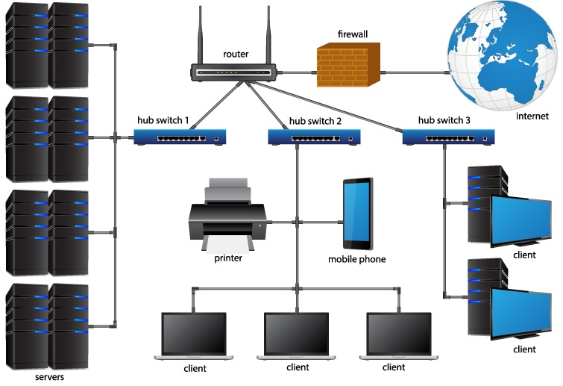
Network Management Design

Slide 5
Proactive Network Management
Plan to check the health of the network during normal operation, not just when there are problems
Recognize potential problems as they develop
Optimize performance
Plan upgrades appropriately

Slide 6
Network Management Processes According to the ISO
Fault management
Configuration management
Accounting management
Performance management
Security management

Slide 7
Fault Management
Detect, isolate, diagnose, and correct problems
Report status to end users and managers
Track trends related to problems

Slide 8
Configuration Management
Keep track of network devices and their configurations
Maintain an inventory of network assets
Log versions of operating systems and applications

Slide 9
Accounting Management
Keep track of network usage by departments or individuals
Facilitate usage-based billing
Find abusers who use more resources than they should

Slide 10
Performance Management
Monitor end-to-end performance
Also monitor component performance (individual links and devices)
Test reachability
Measure response times
Measure traffic flow and volume
Record route changes

Slide 11
Security Management
Maintain and distribute user names and passwords
Generate, distribute, and store encryption keys
Analyze router, switch, and server configurations for compliance with security policies and procedures
Collect, store, and examine security audit logs

Slide 12
Network Management Components
A managed device is a network node that collects and stores management information
An agent is network-management software that resides in a managed device
A network-management system (NMS) runs applications to display management data, monitor and control managed devices, and communicate with agents

Slide 13
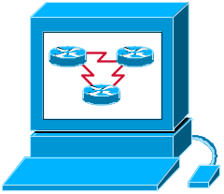



Network Management Architecture
NMS
Agent
Agent
Agent
Management Database
Management Database
Management Database
Managed Devices

Slide 14
Architecture Concerns
In-band versus out-of-band monitoring
  In-band is easier to develop, but results in management data being impacted by network problems
Centralized versus distributed monitoring
  Centralized management is simpler to develop and maintain, but may require huge amounts of information to travel back to a centralized network operations center (NOC)

Slide 15
Simple Network Management Protocol (SNMP)
Most popular network management protocol
SNMPv3 should gradually supplant versions 1 and 2 because it offers better authentication
SNMP works with Management Information Bases (MIBs)

Slide 16
Remote Monitoring (RMON)
Developed by the IETF in the early 1990s to address shortcomings in standard MIBs
  Provides information on data link and physical layer parameters
  Nine groups of data for Ethernet
  The statistics group tracks packets, octets, packet-size distribution, broadcasts, collisions, dropped packets, fragments, CRC and alignment errors, jabbers, and undersized and oversized packets

Slide 17
Cisco Tools
Cisco Discovery Protocol
  With the show cdp neighbors detail command, you can display detailed information about neighboring routers and switches, including which protocols are enabled, network addresses for enabled protocols, the number and types of interfaces, the type of platform and its capabilities, and the version of Cisco IOS Software running on the neighbor.
NetFlow Accounting
  An integral part of Cisco IOS Software that collects and measures data as it enters router or switch interfaces

Slide 18
Summary
Determine which resources to monitor, which data about these resources to collect, and how to interpret that data
Develop processes that address performance, fault, configuration, security, and accounting management
Develop a network management architecture
Select management protocols and tools

Slide 19
Review Questions
Why is network management design important?
Define the five types of network management processes according to the ISO.
What are some advantages and disadvantages of using in-band network management versus out-of-band network management?
What are some advantages and disadvantages of using centralized network management versus distributed network management?

